Slide 1
Proportions and relationships
Saryu Onishi
HES 3000-002, Sport Performance Analytics

Slide 2
Workflow
Open and inspect
Identify the observation and variables
Prepare the values
Choose and make a graph
Summarize
Interpret

Slide 3
What am I looking at?
What does one row represent?
What does each column represent?
Which columns are numeric or categorical?
Are there blank cells, labels mixed with values, or units in the cells?
Recall: data characteristics slides.

Slide 4
Which values answer the question?
Defined by your research question
  Eg: study of offensive performance? → field goal percentage?
Recall: unit of observation and data structure.
Notes:
In Excel, select or prepare the values you’ll actually analyze.

Slide 5
Inspecting data
game_id | team_id | opponent_team_id | athlete_id | field_goals_made | field_goals_attempted | fg%
401858379 | 201 | 38 | 5329888 | 0 | 2 | 0%
401851568 | 201 | 8 | 5329888 | 2 | 2 | 100%
401851564 | 201 | 245 | 5329888 | 3 | 4 | 75%
401851560 | 201 | 2579 | 5329888 | 0 | 0 | 0%
401808287 | 201 | 251 | 5329888 | 1 | 3 | 33%
401808280 | 201 | 142 | 5329888 | 2 | 5 | 40%
401808269 | 201 | 99 | 5329888 | 1 | 3 | 33%
401808262 | 201 | 2 | 5329888 | 0 | 0 | 0%
401808256 | 201 | 245 | 5329888 | 0 | 1 | 0%
401808247 | 201 | 2633 | 5329888 | 0 | 1 | 0%
401808239 | 201 | 61 | 5329888 | 3 | 3 | 100%
401808225 | 201 | 238 | 5329888 | 0 | 1 | 0%
401808216 | 201 | 96 | 5329888 | 2 | 4 | 50%
401808214 | 201 | 251 | 5329888 | 4 | 10 | 40%
401808206 | 201 | 8 | 5329888 | 1 | 1 | 100%
401808196 | 201 | 142 | 5329888 | 3 | 5 | 60%
401808191 | 201 | 2579 | 5329888 | 1 | 2 | 50%
401808184 | 201 | 333 | 5329888 | 2 | 3 | 67%
401808172 | 201 | 57 | 5329888 | 4 | 4 | 100%
401808166 | 201 | 245 | 5329888 | 1 | 1 | 100%
401808154 | 201 | 344 | 5329888 | 0 | 2 | 0%
401808151 | 201 | 145 | 5329888 | 0 | 1 | 0%
401826782 | 201 | 2400 | 5329888 | 2 | 3 | 67%
401858385 | 201 | 277 | 5144388 | 0 | 1 | 0%
401858385 | 201 | 277 | 5101844 | 3 | 3 | 100%
401858383 | 201 | 239 | 5144388 | 2 | 4 | 50%
401858383 | 201 | 239 | 5101844 | 2 | 2 | 100%
Describing one row is a descriptive. Do not need to report metrics.
  “each row represents a single athlete’s performance in one game of the 2026 season”
  “a summary of a team’s performance last season”
Understanding the data is critical for all future steps.
  Data type affects which summaries and graphs make sense. (mode vs mean, color vs position)
  Is the data valid? (can fg% be 0 if fg attempted is 0?)
*sample rows from the full dataset

Slide 6
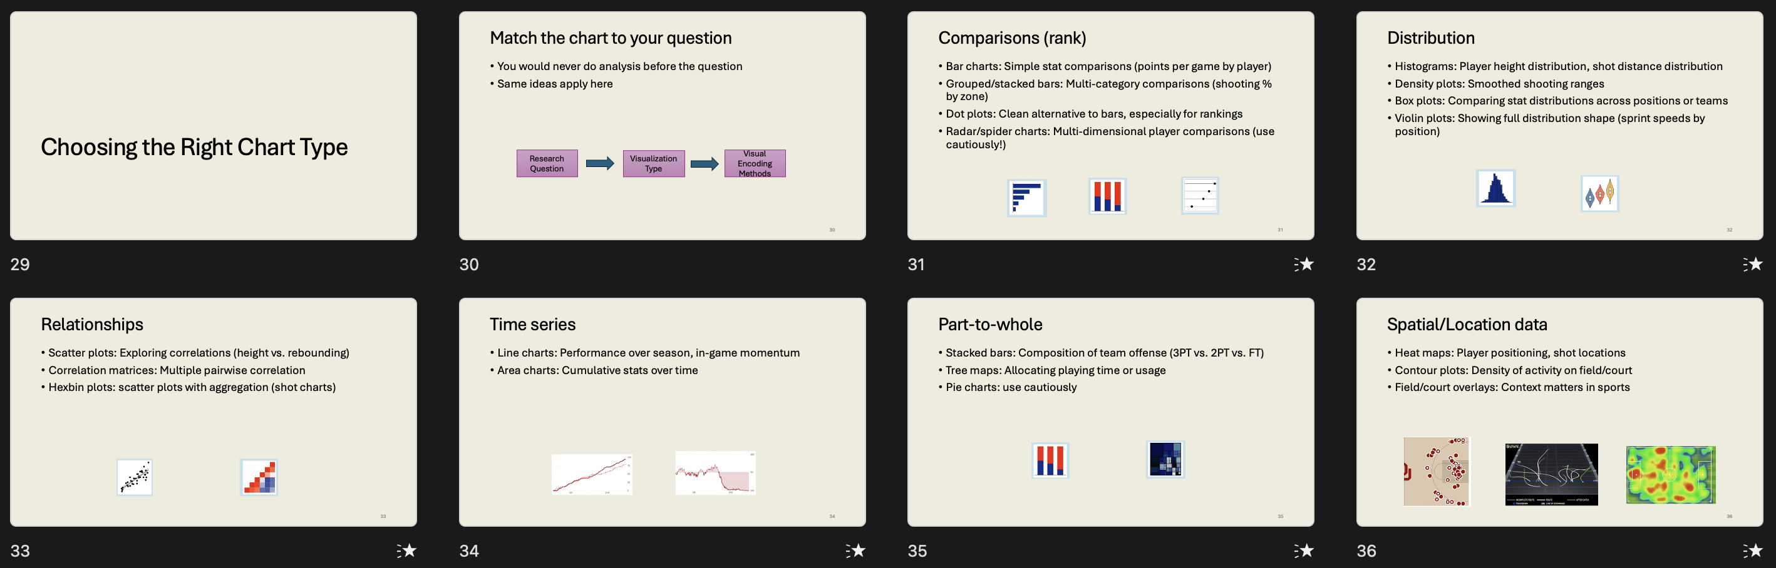
Which graph answers this question?
one numeric variable → distribution → histogram.
Recall: chart choice follows the question.

Slide 7
Making the histogram
one observation per row and values in one column
Recall: long format data for visualization and analysis
Notes:
Make the histogram live in Excel.

Slide 8
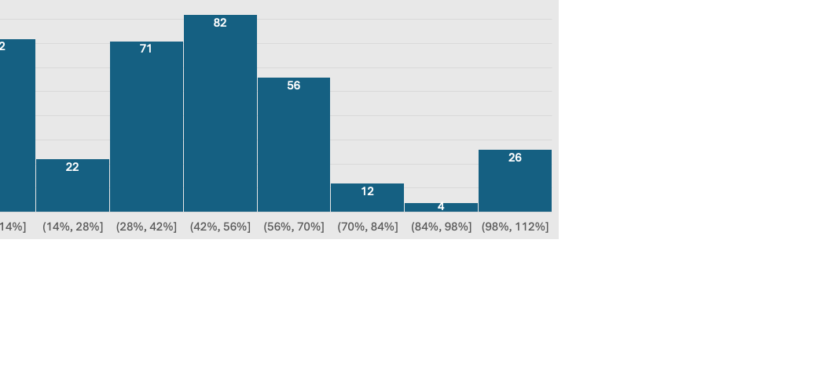
What does the distribution tell us?
Describe the shape, range/spread, clusters, unusual values.
Would the mean or median better describe a typical value here, and why?
Notes:
Calculate the relevant statistics live and write a brief interpretation.

Slide 9
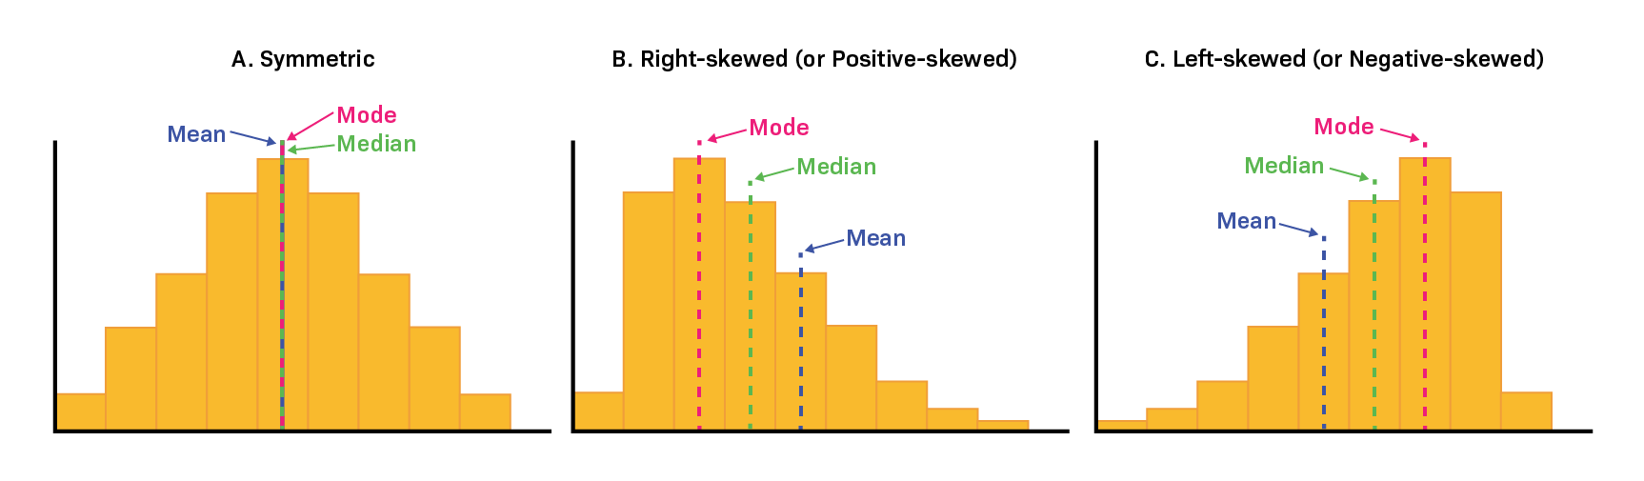
What does the distribution tell us?
Recall: center and spread lecture.

Slide 10
Bonus: What changes when we compare groups?
Requires additional columns
Do overall averages hides meaningful differences?
Notes:
Keep this brief; it’s bonus work, so you don’t need to teach every Excel route to it.

Slide 11
Bonus: What changes when we compare groups?
 | n | mean fg%
Full team | 345 | 42.1%
status | n | mean fg%
starter | 185 | 50%
bench | 160 | 33%
What does this tell us?
Notes:
Keep this brief; it’s bonus work, so you don’t need to teach every Excel route to it.

Slide 12
Proportions and relationships
Notes:
Section 1: Central tendency
What is typical?

Slide 13
Proportions in sports
Question:
What proportion of recorded sessions were games, practices, or strength sessions?
What proportion of successful shots were off short pass sequences (< 3 passes)?
what proportion of the team improved in their agility test?

Slide 14
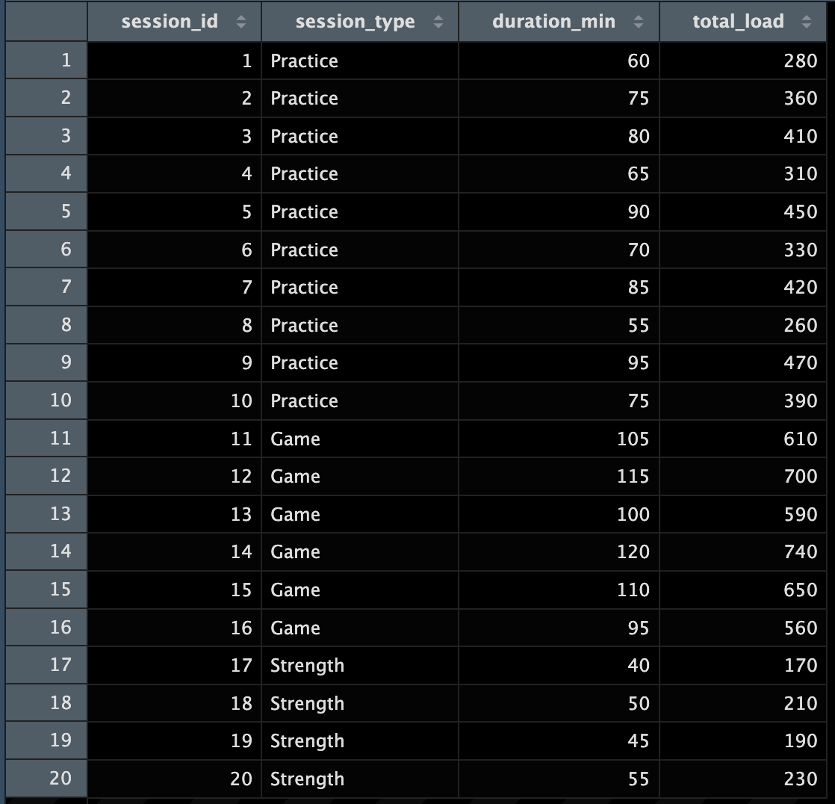
Proportions in sports
A proportion describes a part of a defined whole.
Proportion = number in a category ÷ total number
Before calculating:
  What does one row represent?
  What counts as the whole?

Slide 15
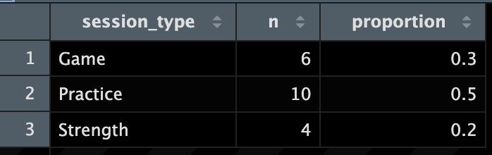
Calculating proportions

Slide 16
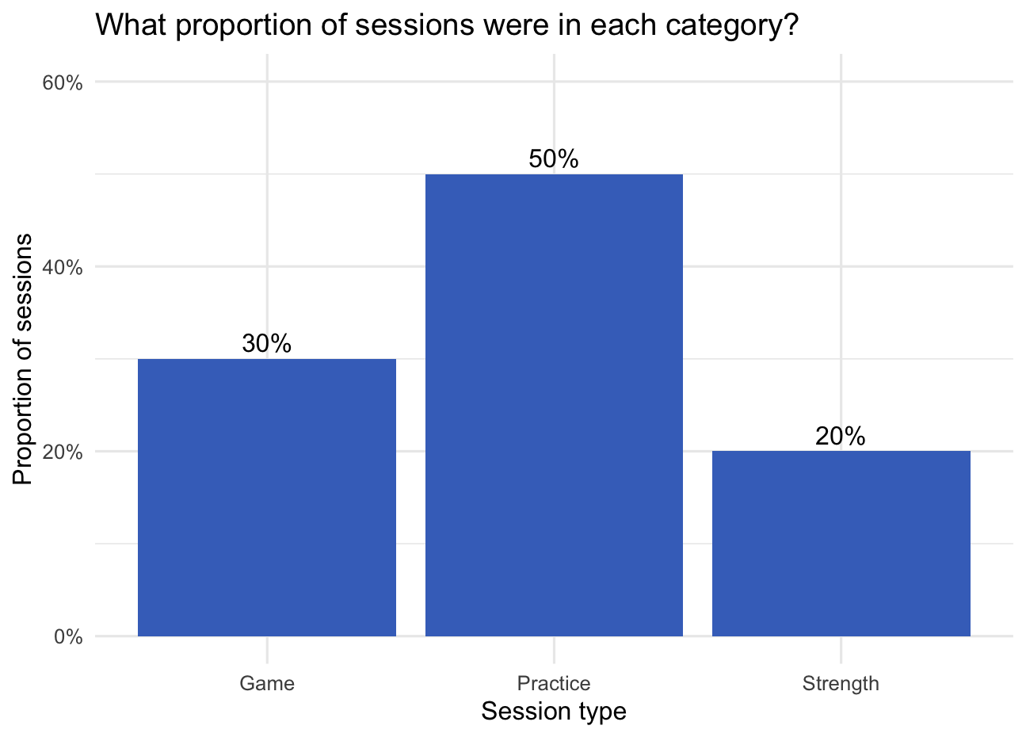
Choosing a chart for proportions
Question: Which session type was most common?
Use a bar chart to compare categories.
  categories on one axis and counts or percentages on the other.
  Label whether the bars show counts or percentages.

Slide 17
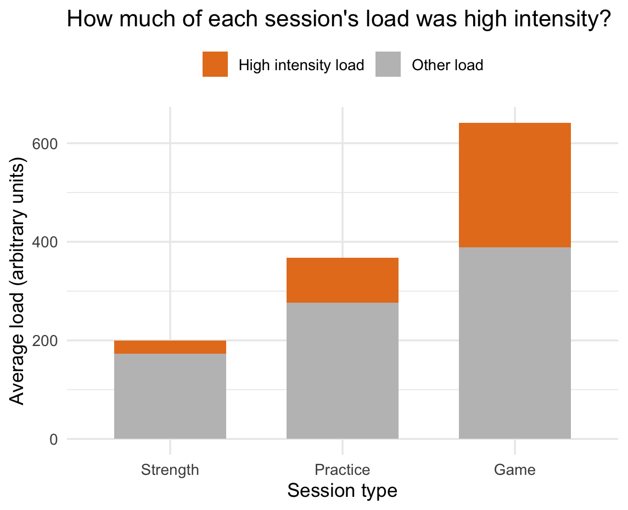
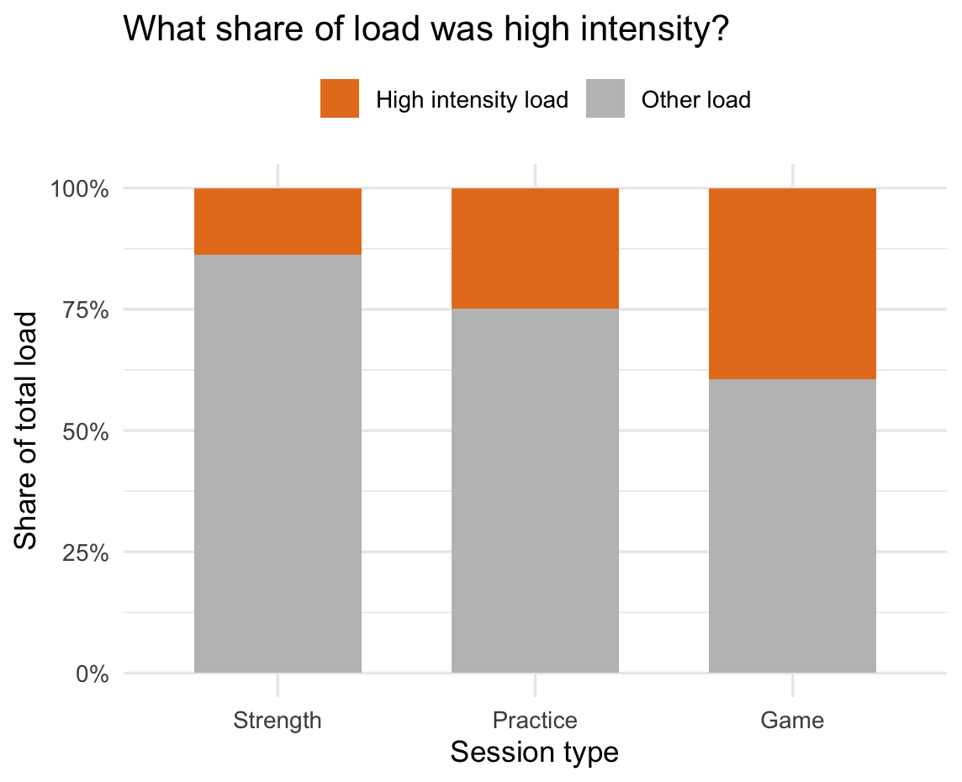
Choosing a chart for proportions
Question: How is the load within each session type divided between high intensity and other load?
*Each bar represents the average total load per session. Each section show high intensity and other load.

Slide 18
Choosing a chart for proportions
Question: How is the load within each session type divided between high intensity and other load?
Stacked bar chart when the parts add up to a meaningful total.
100% stacked bar chart if the question is about the proportion only.

Slide 19
Data for relationships
We need two numeric variables measured on the same observation.

Slide 20
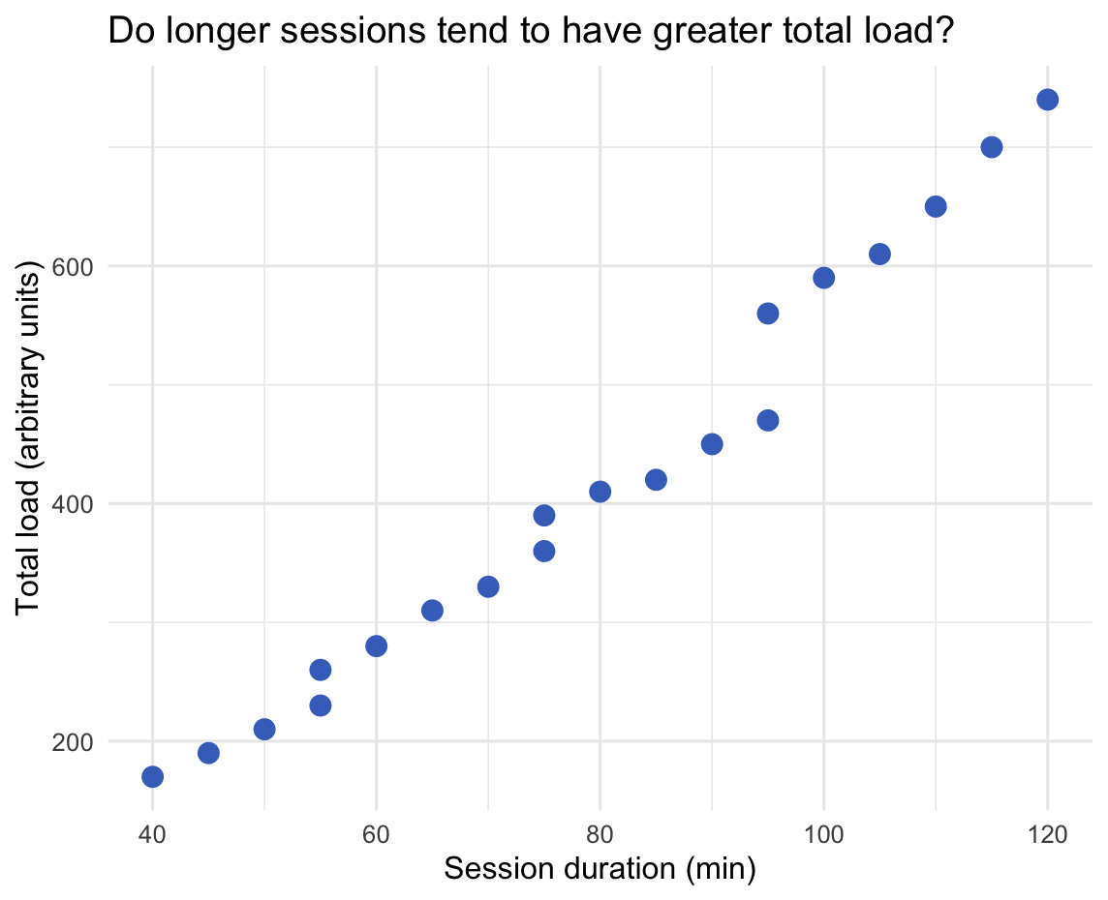
Visualizing relationships
Scatterplots:
Explanatory variable on the x-axis and the outcome on the y-axis.
  x-axis = duration
  y-axis = total load
Each point represents one session (or one athlete-session, depending on your data).

Slide 21
Reading a scatterplot
What pattern do you see?
Direction:
  Do higher values of one variable tend to occur with higher or lower values of the other?
Shape:
  Is the pattern roughly straight, curved, or unclear?
Spread:
  How closely do the points follow the pattern?
Unusual points or groups:
  Is anything worth a closer look?
Notes:
In these data, sessions with longer durations tended to ______.

Slide 22
Interpreting graphs
Observation:
Longer sessions tended to have greater total load.
Questions the graph alone cannot answer:
Were those sessions more intense, or simply longer?
Does duration itself explain the pattern?
Would the same pattern appear within each session type?

Slide 23
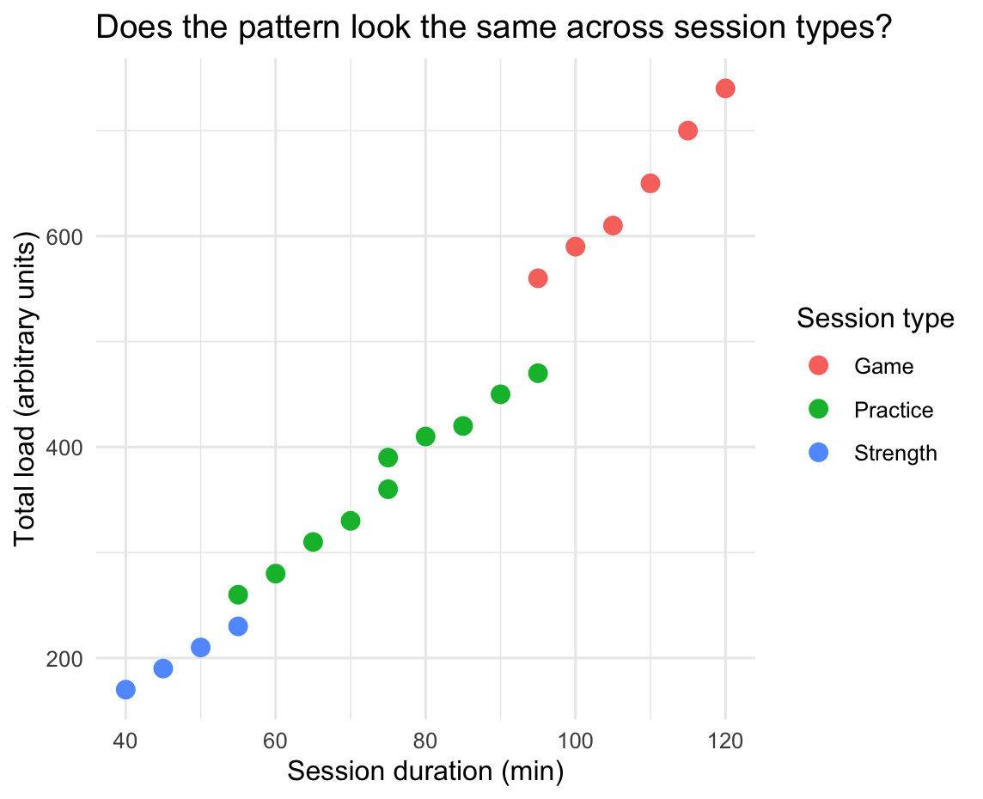
Comparing groups

Slide 24
Summary
Workflow: Start with the question, inspect the data, choose a graph, then interpret it.
Proportions: Define the whole before calculating or graphing its parts.
Relationships: Use a scatterplot to see how two numeric variables vary together. Describe the pattern before explaining it.
Next time
Exam review: Bring questions from the lectures and case studies.

